Slide 1
Digital Portfolio
STUDENT NAME: Chandru
REGISTER NO AND NMID: 222404553/
DEPARTMENT: BSC.SOFTWARE APPLICATION
COLLEGE: COLLEGE/ UNIVERSITY:A.M JAIN COLLEGE

Slide 2
PROJECT TITLE DIGITAL PORTFOLIO

Slide 3


AGENDA
Problem Statement
Project Overview
End Users
Tools and Technologies
Portfolio design and Layout
Features and Functionality
Results and Screenshots
Conclusion
Github Link
3/21/2024 Annual Review

Slide 4

PROBLEM STATEMENT 1) Building The structure 2)Giving perfect colors 3)Inserting pictures 4)Making Scrolling smooth 5)Making it Responsive

Slide 5

PROJECT OVERVIEW A Difital portfolio fully attached about my skills in the software world and also it holds my project I have linked my github,linkedin,Twitter profile

Slide 6

WHO ARE THE END USERS? The End Users are.. The companies I go for interview My Online Clients

Slide 7

TOOLS AND TECHNIQUES HTML CSS JAVASCRIPT

Slide 8
POTFOLIO DESIGN AND LAYOUT
It has a maginificent purple blended
Violet colors and it has myprofile photo,
My name in the starting after scrolling down you can find my projects,and what skills do I have and lastly you got a information box to fill up your details and get in touch with me….
-Thank you!!
8

Slide 9
FEATURES AND FUNCTIONALITY Displays My Essential Details scrolls smootly it has a Arrow button in the left to scroll up from down

Slide 10
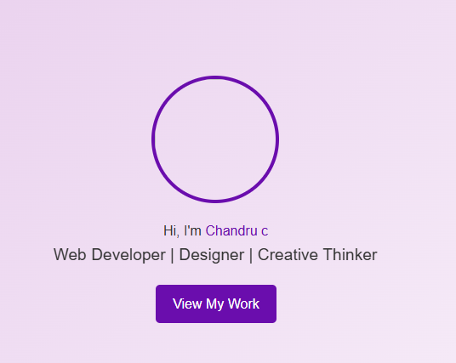
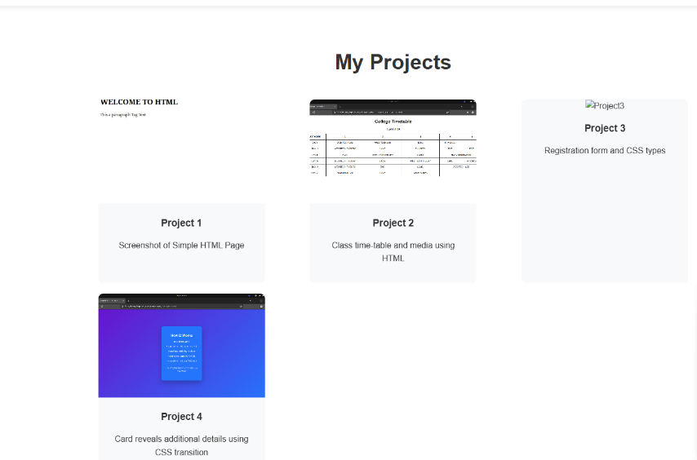

RESULTS AND SCREENSHOTS
3/21/2024 Annual Review
10

Slide 11
CONCLUSION I have created this portfolio with my hardwork and consistency Deployment link: https://24j017-chandru.github.io/TNSDC-FWD-DigitalPortfolio/ Server link: https://github.com/24j017-chandru/TNSDC-FWD-DigitalPortfolio.git
11

